Slide 1
PLL City Network Video

Slide 2
Transforming cities into playful learning spaces
Notes:
Good afternoon… hope you enjoyed video. Some familiar faces in it… Video provided an overview of PLL and the city network.
Focus on PLL… You heard from Kathy the other week. Know how timely this work is after COVID, given learning loss, questions about future of cities.

Slide 3
Policymakers have focused on improving formal learning environments…but this ignores the 80% of waking hours children spend outsides of school
Photo by Gautam Arora on Unsplash
Notes:
Of course, even before COVID, we had achievement gaps that start early.
In fact, achievement gaps between cognitive and social skills of middle-income children and their peers from under-resourced areas emerge as early as age 3.
This sets the trajectory that leads children from under-resourced areas to poorer academic performance over time.
Early childhood education is one of the most powerful mechanisms for bridging these gaps and increasing social mobility and economic opportunity.
In discussions on how to close educational gaps, most of the emphasis is on schools.
However, over the course of their childhood children in Western countries spend only 20% of their waking hours in school.

Slide 4
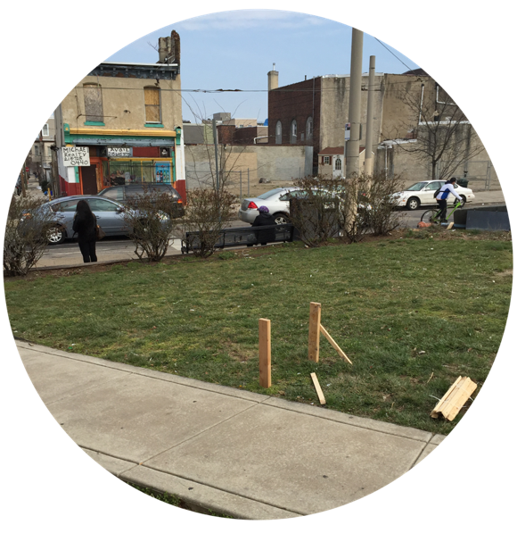
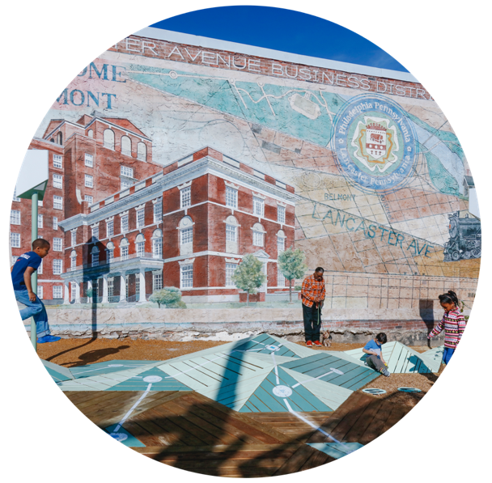
What if we transformed community spaces into joyful learning opportunities?
Notes:
Playful Learning Landscapes capitalizes on the other 80% by augmenting school learning through public spaces designed to encourage culturally relevant playful learning that stimulates academic and social outcomes across a breadth of skills.

Slide 5
Expanding opportunity through:
Education
Playful
Learning
Landscapes
Placemaking
Notes:
By addressing educational inequity through a holistic, community-based model, PLL sets in motion transformative and structural change at the individual-, family-, and community-levels that broadens economic opportunity and encourages social mobility.

Slide 6
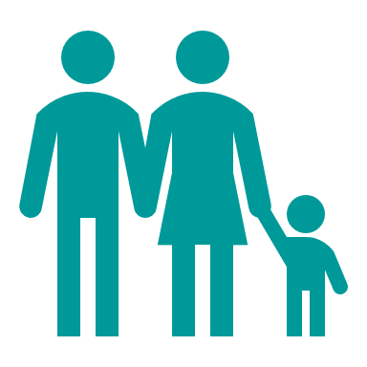
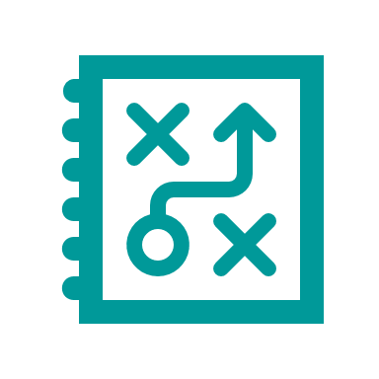
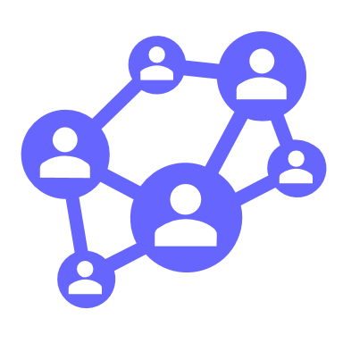
Playful Learning Landscapes
Increases caregiver-child interaction
Revitalizes public spaces
Galvanizes community networks
Encourages talk about numbers, letters, and spatial relations
Notes:
While there is no silver bullet for inequity, PLL offers a powerful solution with a wide range of outcomes.
PLL fosters a mindset shift among caregivers and communities around the role of caregiver-child interactions and play in promoting learning.
At the same time, PLL makes promotes community engagement, social interaction among neighbors, and makes cities more vibrant and livable for all residents.

Slide 7
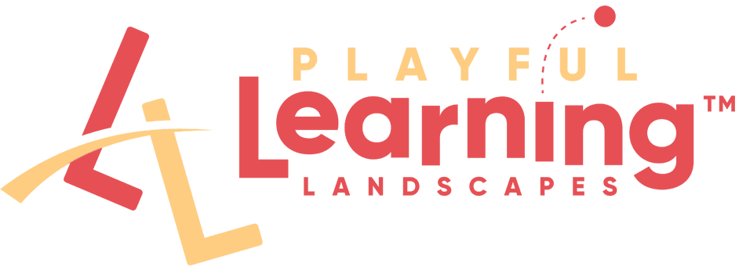
Notes:
The PLL initiative is a collaboration between the Brookings Institution, the PLL Action Network, and academic researchers working to understand how discoveries from developmental science on how people learn best can be leveraged in the design of public spaces.
The concept of playful learning is based on a body of developmental research led over the past decade by Kathy Hirsh Pasek's research lab at Temple University and her lifelong collaborator Roberta Golinkoff at University of Delaware.
PLLAN supports communities to design and implement PLL in cities across the U.S. and internationally by providing technical assistance and research-based guidance on how to infuse playful learning in public and shared spaces.
This initiative was officially launched at Brookings as a partnership between CUE and the Bass Center for Transformative Placemaking to build on and scale the concept in cities around the country.

Slide 8
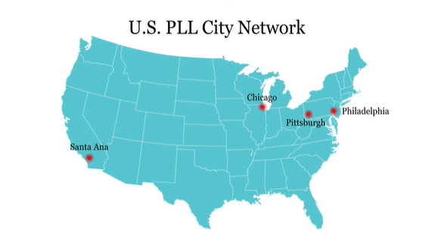
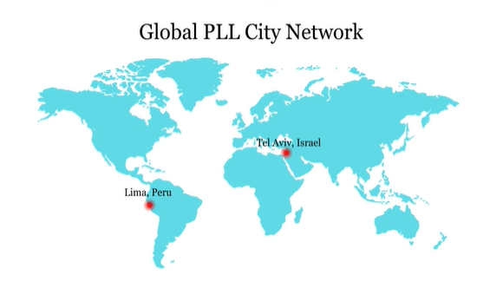
The Playful Learning Landscapes City Network
Notes:
Playful learning is gaining wider momentum, with cities around the world understanding the need to rethink neighborhood investments to enhance health, well-being, and economic opportunity.
As showcased in the video, Brookings is bringing together city-level leaders and stakeholders through our City Network to share, learn, and inspire each other as we continue to build the momentum and engagement around playful learning in urban spaces. Our network currently consists of 6 cities: Chicago, Philadelphia, Pittsburgh, Santa Ana, Lima and Tel Aviv.

Slide 9
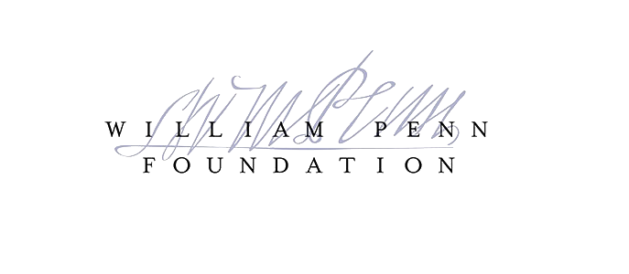
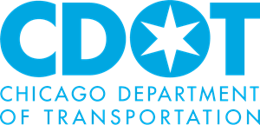
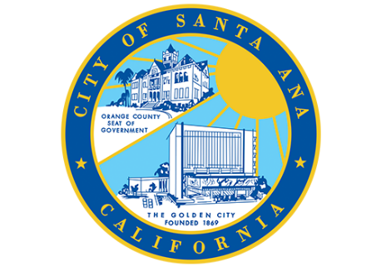
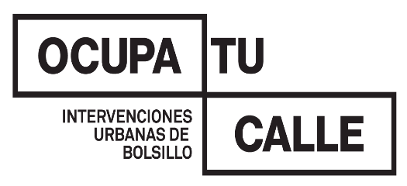
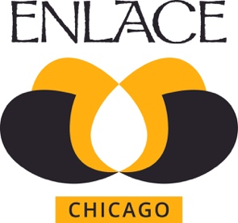
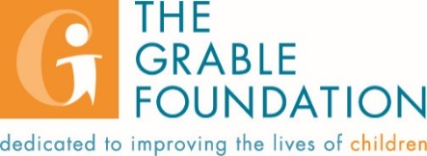
Notes:
Teams from each of the 6 cities meet quarterly.
Teams are a mix individuals from the nonprofit, philanthropic, public sector.
Purpose is to learn from one another, from Brookings, for occasional guest presenters. Network also helps strengthen relationship among city team members, who often themselves didn’t regularly interact prior to joining the network.
Share updates on work, hone in on a particular challenge or opportunity.
Brookings learns from the network as well. Informs our research and writings.
Future: Started with 4 cities (Chicago, Phil, Pittsburgh, Tel Aviv), added Santa Ana and then Lima. Would like to continue to expand the network over time, but want to do so thoughtfully.

Slide 10
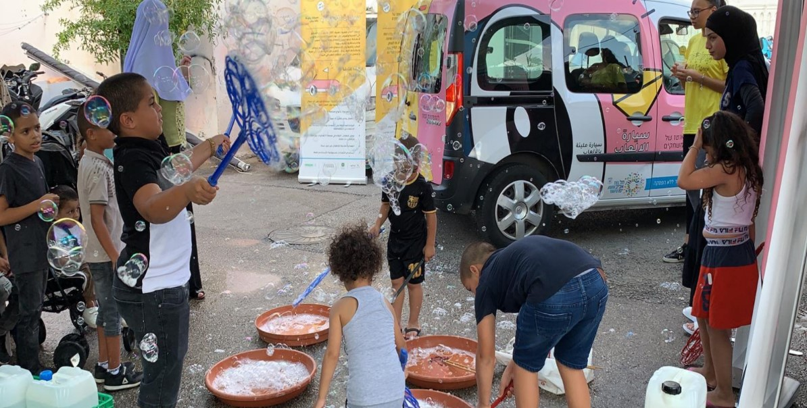
Key learnings:
Roles and responsibilities in facilitating PLL vary from city to city.
PLL can materialize for different lengths of time—from seasonal or annual events to permanent installations.
PLL events can build momentum and catalyze a city’s movement by sustaining collaborations throughout the year.
PLL initiatives can reclaim public spaces for children and families, making safe play and playful learning more accessible.
Credit: Urban95
Notes:
Conversations from recent network meetings have yielded several key insights that could help inform other local efforts to enhance playful learning opportunities in their communities:
1. Designing and implementing PLL ideally involves public sector collaboration, but in practice this can vary. The public sector isn’t currently involved in all efforts. Lima’s efforts, for example, are exclusively led by Ocupa tu Calle, a nonprofit organization. On other hand, some city governments are intimately involved in directing the PLL movement in their city. The city of Philadelphia, for example, created a specific role within the city government, dubbed the Playful Learning Fellow, which oversees PLL projects. Moreover, the city is often a main partner in such projects. For instance, Play Parks was brought to life by the William Penn Foundation and Philadelphia Parks and Recreation, and Parks and Rec functioned as the coordinating entity that engaged the many different partners. A mix in other network cities.
2: PLL projects must be adapted to each community’s needs and available opportunities. For example: (Temp/seasona) Tel Aviv’s Play Streets provide seasonal, regularly scheduled playful learning, delivered to neighborhood streets via a Play Van. The project began in 2019 with a Playcar pilot, which brought 12 sessions of playful learning activities to parks and gardens in the city. (More permanent): While temporary or movable installations have the benefit of reaching a broad range of communities, permanent, well-maintained installations remain at the heart of the PLL movement. For example, in Santa Ana the Abacus Bus Stop emerged from an extensive community engagement process in which parents reflected on learning to count.
3. Behind the scenes, annual events can advance a city’s PLL movement beyond the events themselves. Pittsburgh’s Ultimate Play Day (UPD) brings togethers various actors—Trying Together, CitiParks, the Grable Foundation, and the Carnegie Museum of Art, among others—to plan an annual day of fun for families in the city. Motivated by a joint yearly goal, this unlikely group of partners keeps in regular contact such that their collaboration and impact is sustained beyond that single day.
4. Several cities in the network prioritize giving children and families safe spaces for play through PLL projects. For instance, Philadelphia’s Play Parks initiative works to reclaim public parks in the Kensington neighborhood, where violence and open drug usage are prevalent and children have few safe spaces for stimulating outdoor play. However, by clearly demarcating three parks for children and families through the use of regular scheduling, park ranger staff presence, and physical boundaries, Play Parks provides safe and enriching playful learning opportunities for Kensington’s children. LIMA: Lima’s Urunaga Park is a permanent installation that rebuilt the park into an activities circuit for the local kids. Since the park was dangerous to access via local streets, the team created a new pedestrian crossing so that children from the local school had a safer passageway.
These are just highlights. I’ll pass it on to colleagues from Chicago and Pittsburgh…

