Slide 1
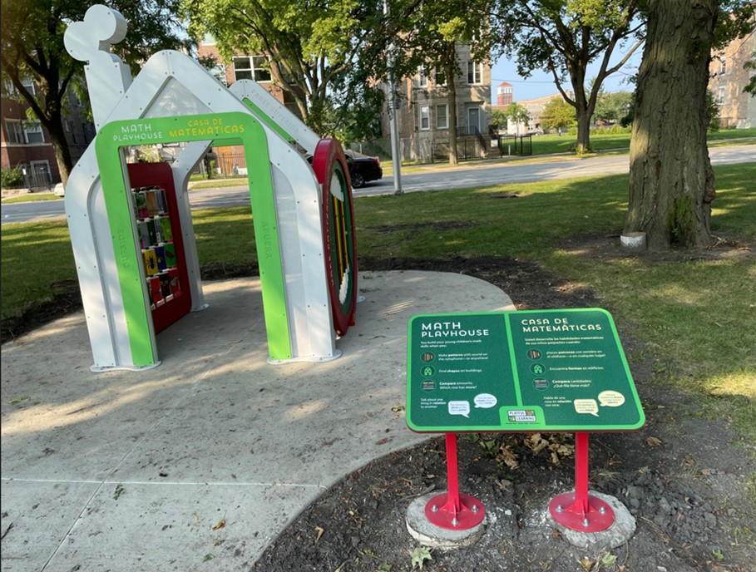
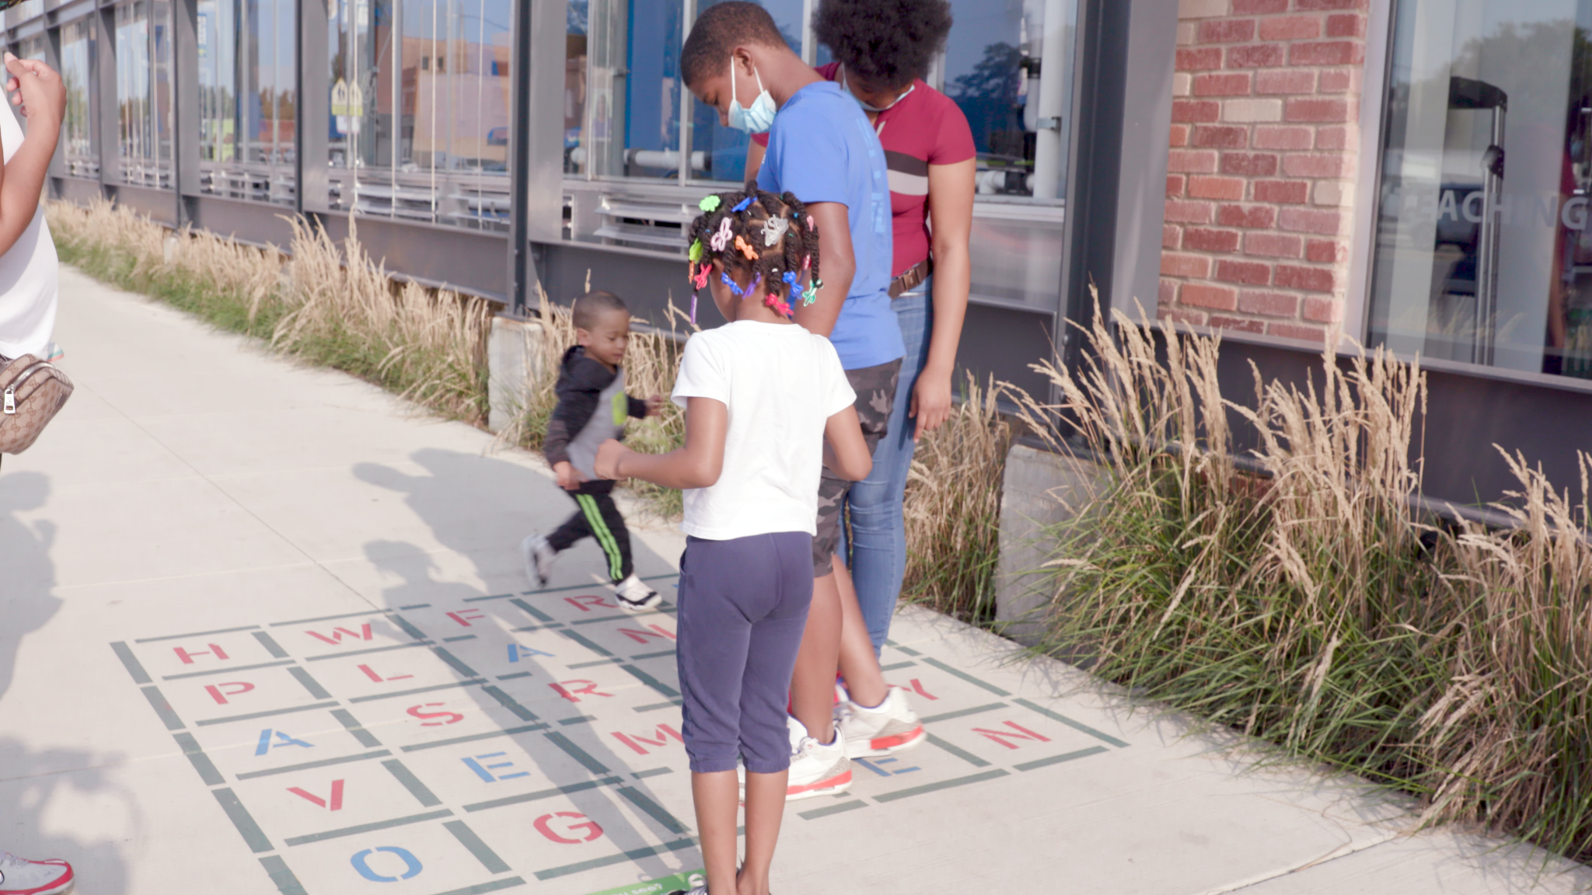
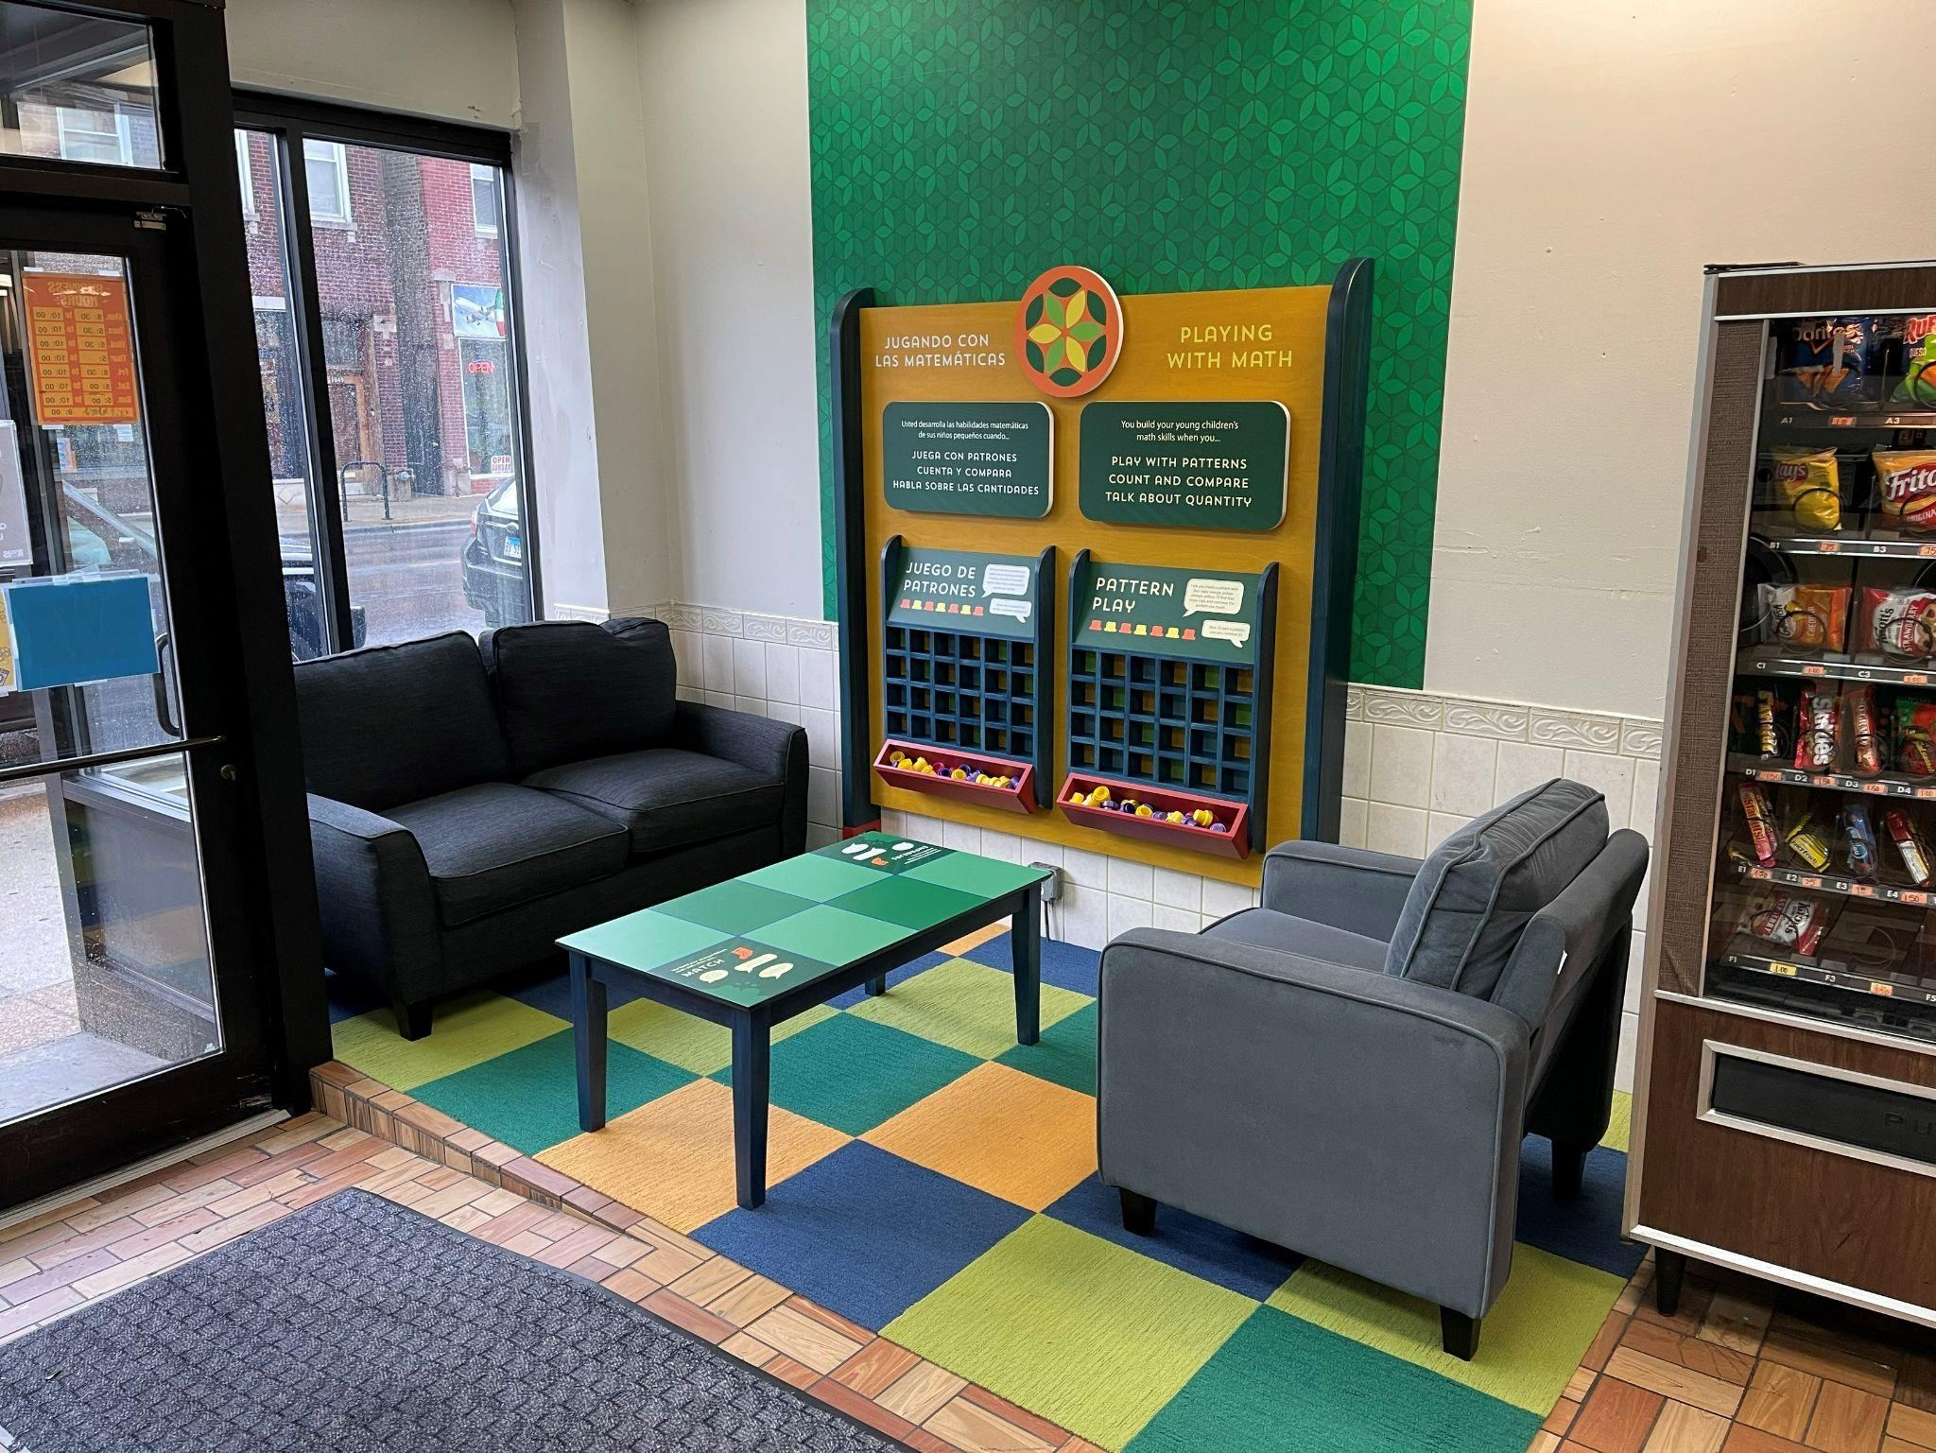
Building Playful Learning Landscapes for Illinois Families
Notes:
Bryan

Slide 2
Getting Started
Notes:
Bryan

Slide 3
Playful Learning in Illinois
Initiative launched in 2017
Collaborative of six initial funders serving as a Steering Committee to support and help grow the project.
Metropolitan Family Services, a regional non-profit organization, leads implementation of the project.
Installations have been completed in the Chicago communities of Little Village and North Lawndale and the city of Aurora.
Notes:
Bryan
11 landscapes installed so far
Now moving on to literacy-focused installations

Slide 4
Partnerships and Collaborations
Notes:
Bryan
Funders came together to launch initiative, but it is driven by community needs
Community partners in each community convene stakeholders for planning in partnership with Metropolitan Family Services at the Chicago Children’s Museum
MFS
Chicago Children’s Museum
CDOT
Illinois Action for Children
ENLACE
CPS
Carole Robertson Center
SPARK Aurora
NLLCCC GROWSS
Beyond the Ball
Open Books
The Encompassing Center
North Lawndale Discovery Center
Aurora Housing Authority
Bridgewater Studios
Legat Architects
North Lawndale Discovery Center
Family Child Resource Center

Slide 5
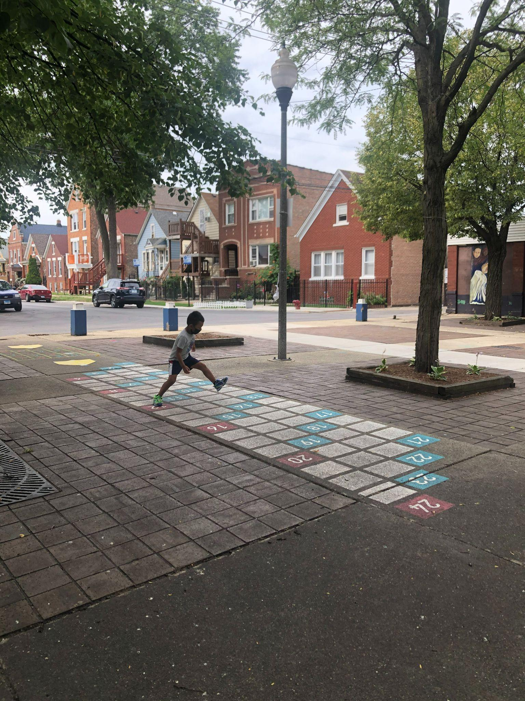
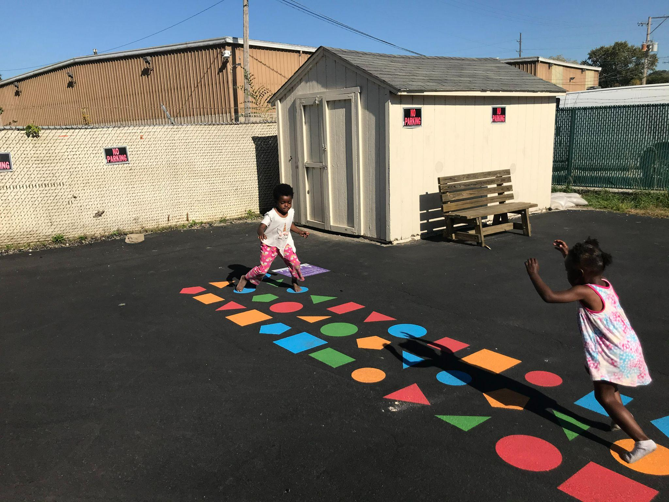
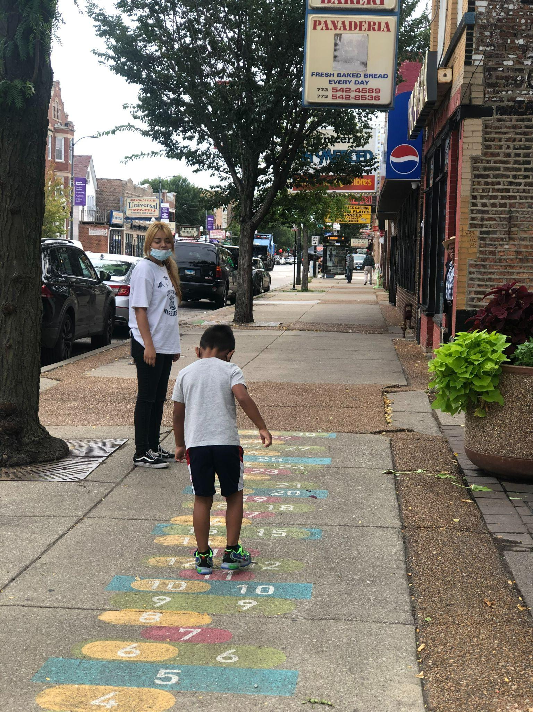
Phase I Installations
Installed August, 2020
Notes:
Jesύs

Slide 6
North Lawndale

Slide 7
Aurora

Slide 8
Little Village

Slide 9
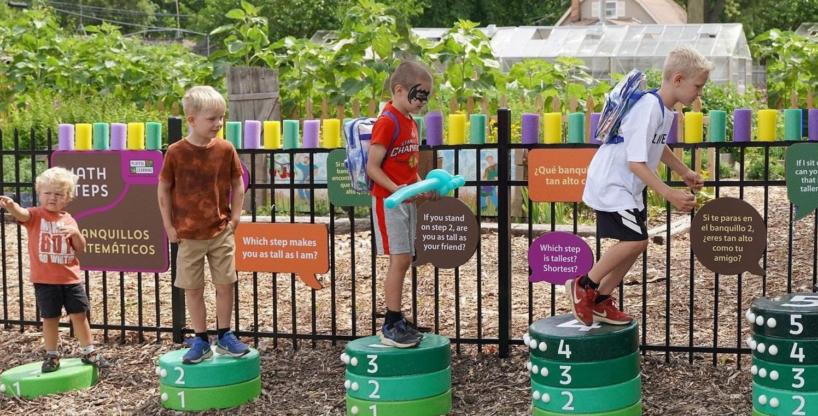
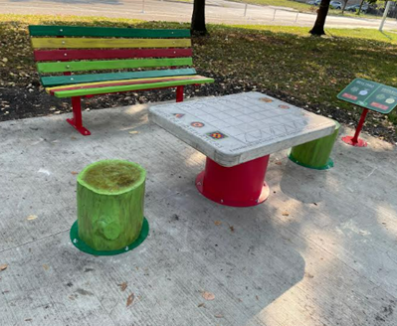
Phase II Installations
Installed 2021-22
Notes:
Jesύs

Slide 10
Little Village

Slide 11
Aurora

Slide 12
North Lawndale

Slide 14
Phase III Installations
Expected Fall of 2023
Notes:
Jesύs

Slide 17
Looking Ahead
2024-25
Notes:
Bryan

Slide 18
Expand Into New Communities
Notes:
Bryan

Slide 19
Nature Based Outdoor Learning with Cognition
Notes:
Jesύs

Slide 20
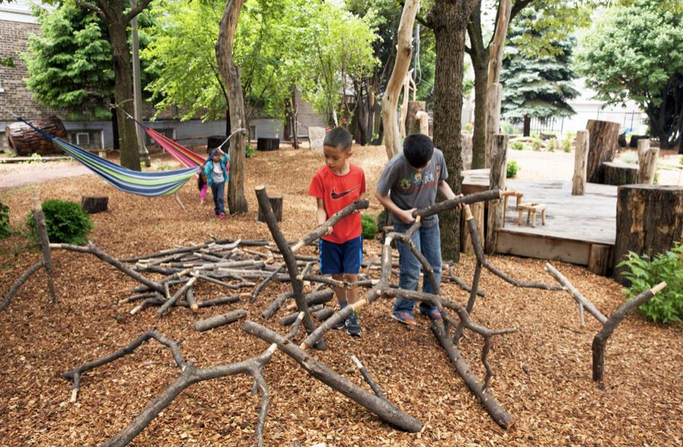
Phase IV - Nature Play, Conservation and Playful Learning
Notes:
Jesύs
Goal to begin this work in 2024

Slide 21
Phase IV Cont. - Nature/Conservation & Playful Learning
In high level dialogue with NLCCC GROWS Committee
Conservation Corridor on 16th to Springfield about Central Park
The corridor then runs north for about a half mile until it reaches Douglas Boulevard, where there is both conservation work and PLL installations
Notes:
Jesύs

Slide 22
Lots on 16th Street Owned by Our Partners
Notes:
Jesύs

Slide 23
Phase V - Technology, Light & Shadows Indoor Installations
Notes:
Jesύs

