Slide 2
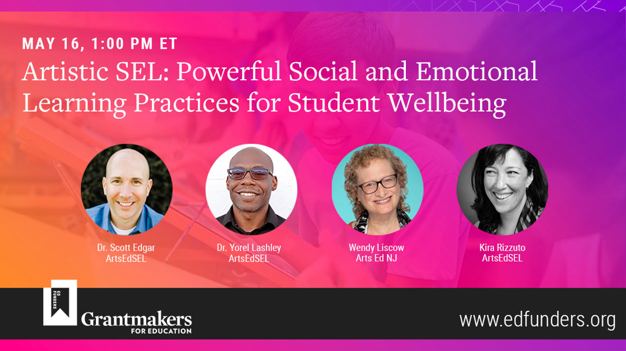
Notes:
Link to Bios

Slide 3
WELCOME!
Please rename yourself with your pronouns and Organization
Notes:
Wendy:
Thank you X for inviting us to participate in this Grantmakers in Education learning series. Prior to my role at Arts Ed NJ I spent 17 years in arts and education philanthropy at the Geraldine R. Dodge Foundation, and am pleased and proud to be a member of the Arts Education
Before we jump in…We ask that you rename yourself using the three dots by your name with your pronouns if you like, and your organization.
Ito share a bit about the work of the Center for Arts Education and SEL.
You are Wendy
Link to Bios:

Slide 4
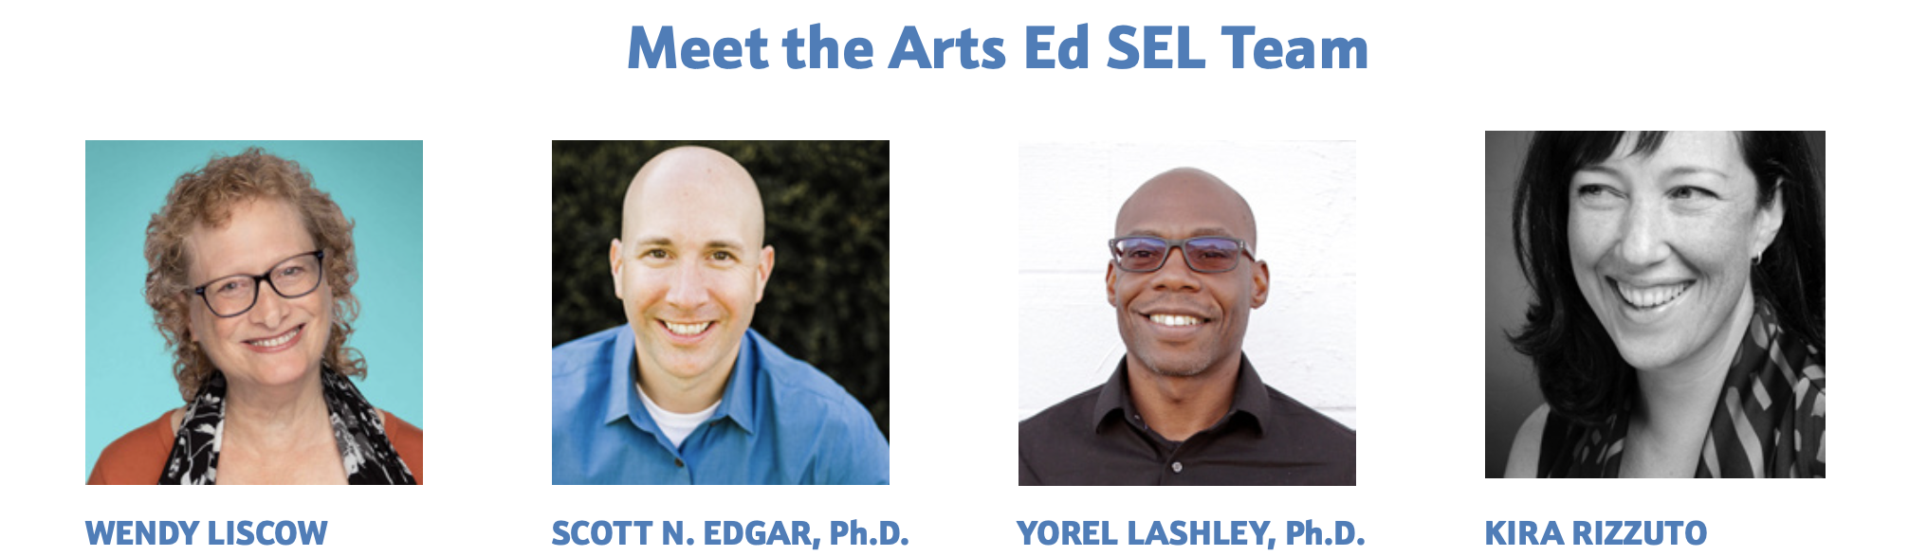
Executive Director
Co-Director of Practice, Learning & Research
Co-Director of Practice, Learning & Research
Director of Programs & Partnerships
Notes:
Wendy, I am thrilled to be with you all as a previous funder

Slide 5
VISION & MISSION
VISION
We imagine a world where everyone engages in the arts to support a strong sense of identity, belonging, and agency, in order to gain a healthy and functional awareness of themselves, make positive contributions to their communities, and have power in their own lives.
MISSION
The Center for Arts Education and Social Emotional Learning (ArtsEdSEL) is dedicated to championing arts education and social emotional learning to facilitate the embedded, intentional, and sustained application of SEL-informed arts education.
Notes:
Wendy: Back when I was still a funder of Education and Arts/Arts Education, I witnessed the amazing connection Mention of our origin story with the framework crosswalk of the five SEL competencies and eleven anchor arts standards.
Had national partners engaged in the work and found that there was national energy around seeing the natural alignment between SEL and the Arts. We always knew that what people called the arts ability to develop “soft” skills were “power skills” Powerful for learning arts, other academics, but also career and life skills. Especially during and post covid.

Slide 6
OBJECTIVES
What is Artistic SEL and why it matters to those who care about student wellbeing
Demonstrate how it looks in action
Key tenets of effective Artistic SEL
Work of the Center for Arts Education and Social Emotional Learning
Notes:
Review objectives for today and hand it over to Kira

Slide 7
CREATIVE SPARK
When or How Did You Engage
With The Arts This Week?
Notes:
Kira–Setup with question in the chat (Pre-meeting–CONFIRM CHAT IS ENABLED)
Various responses: Arts Education teaches us a common vocabulary to think about this range of engagement in the arts.
Link to skill sets

Slide 8
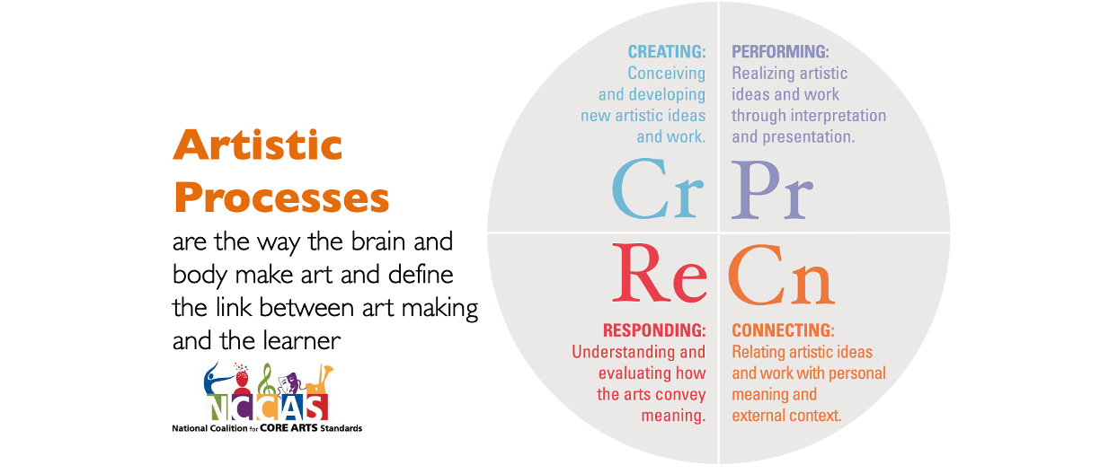
Notes:
Kira–unpack responses with connections to Cr, Pr, Re, Cn
Diagram shows the four artistic processes work together to form a whole–full range of Artistic Expression
pK-13 Practice skills, vocab of the artform and practice how to think like an artist, with artistic ways of knowing and being

Slide 9
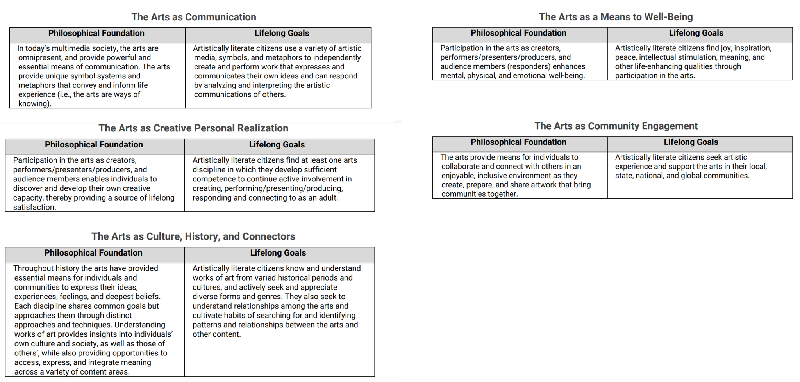
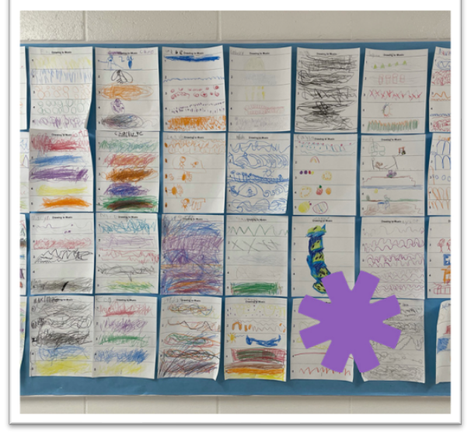
Source: https://www.nationalartsstandards.org/
Notes:
Kira–connect to the language in National Core Arts Standards i.e. Participation in the full range of artistic expression (Cr, Pr, Re, Cn) is often a source of Joy, Inspiration, Peace, and Intellectual Stimulation, [to practice making] meaning and other qualities that enhance life.
Pg. 17“The philosophical foundations and lifelong goals establish the basis for the new standards and illuminate artistic literacy by expressing the overarching common values and expectations for learning in arts education across the five arts disciplines”

Slide 10
SOCIAL EMOTIONAL LEARNING
Equipping ourselves to be whole people who have healthy and functional awareness of ourselves, with loving connections to others that allow us to make positive contributions to our communities, and gives us power over our own lives.
Notes:
Scott

Slide 11
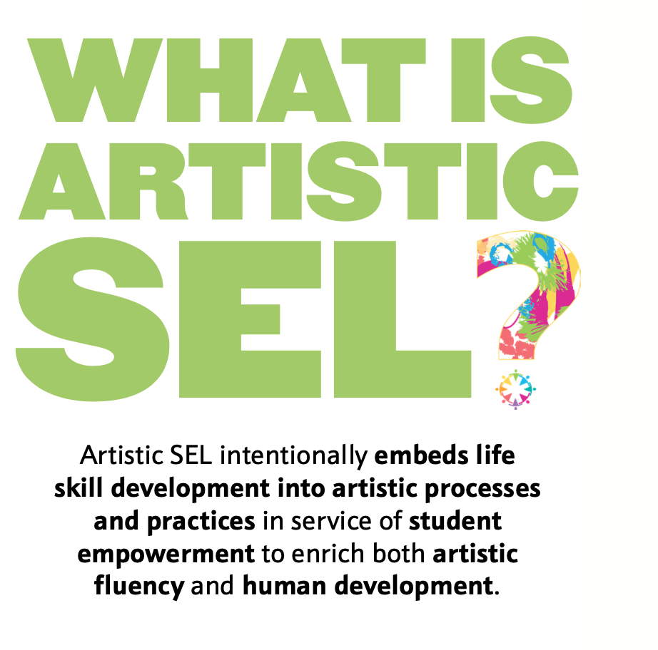
Notes:
Scott: Embedding SEL into Arts and Arts into SEL practices.

Slide 12
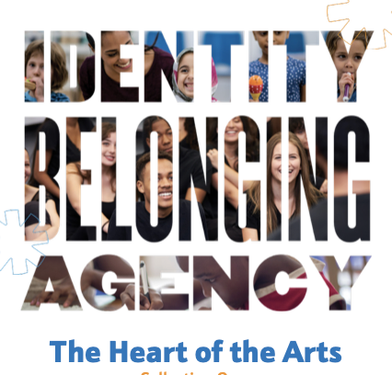
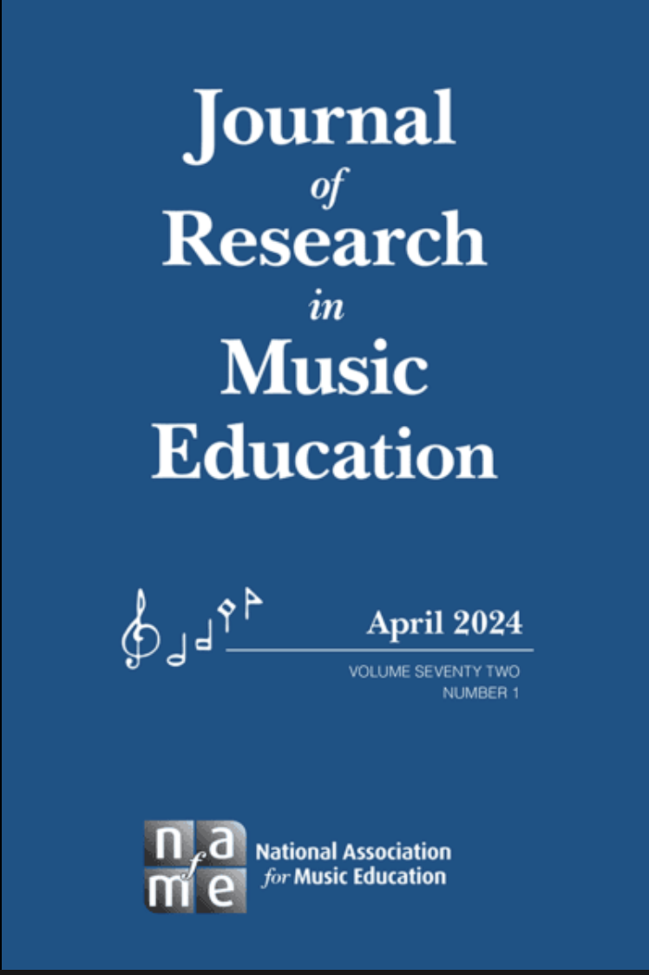
GROUNDED IN PRACTICAL EXPERIENCE & RESEARCH
Notes:
Scott

Slide 13
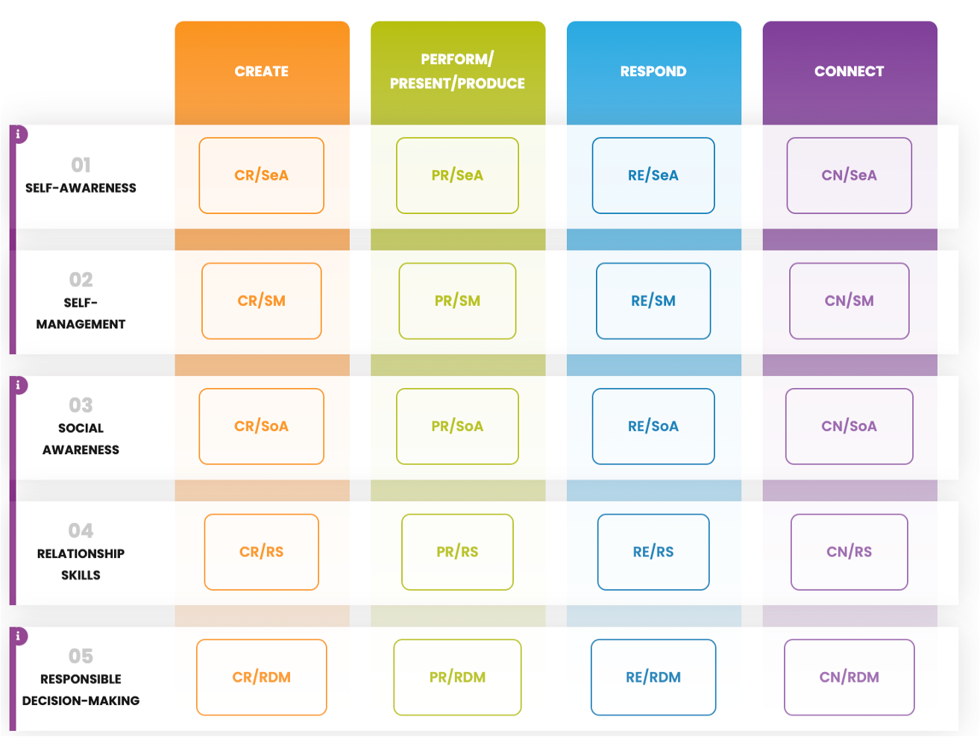
Arts Education and Social Emotional Learning Framework
Notes:
Scott

Slide 14
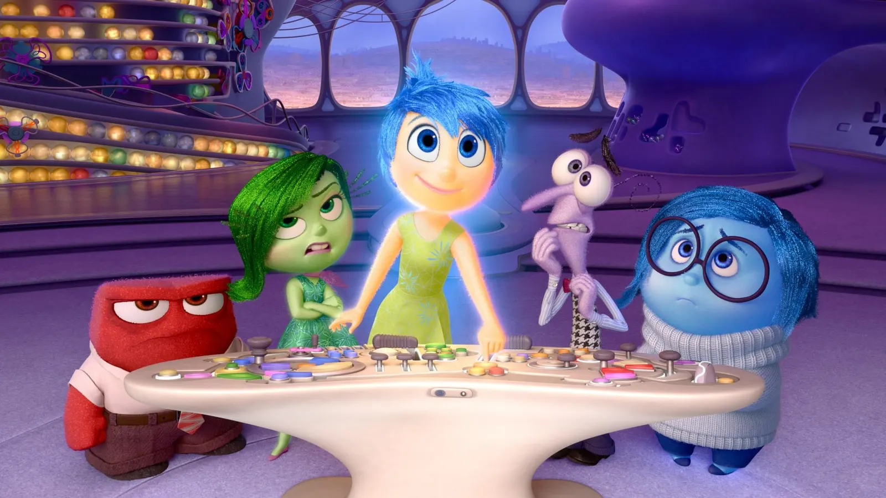
EMOTIONAL SOUNDTRACK
Notes:
Scott

Slide 15
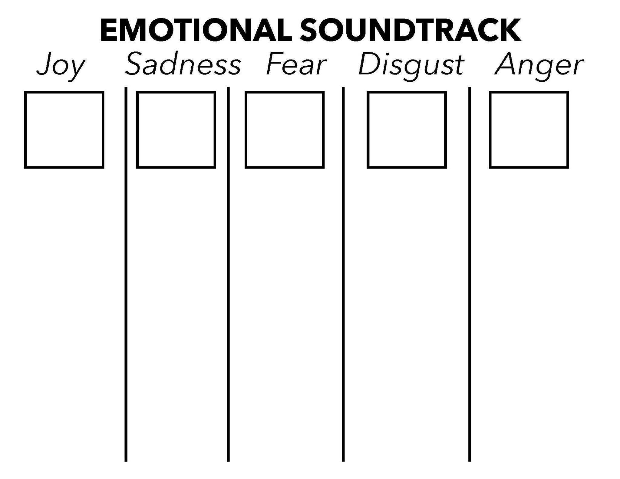
Notes:
Scott

Slide 16
Notes:
Scott

Slide 17
PILLARS
Notes:
Yorel
Given our SEL definition: Equipping ourselves to be whole people who have healthy and functional awareness of ourselves, with loving connections to others that allow us to make positive contributions to our communities, and gives us power over our own lives. Well-being is grounded in healthy sense IAB
The goal of all teaching is to awaken goals, inspire hope and pave the way to dreams

Slide 18
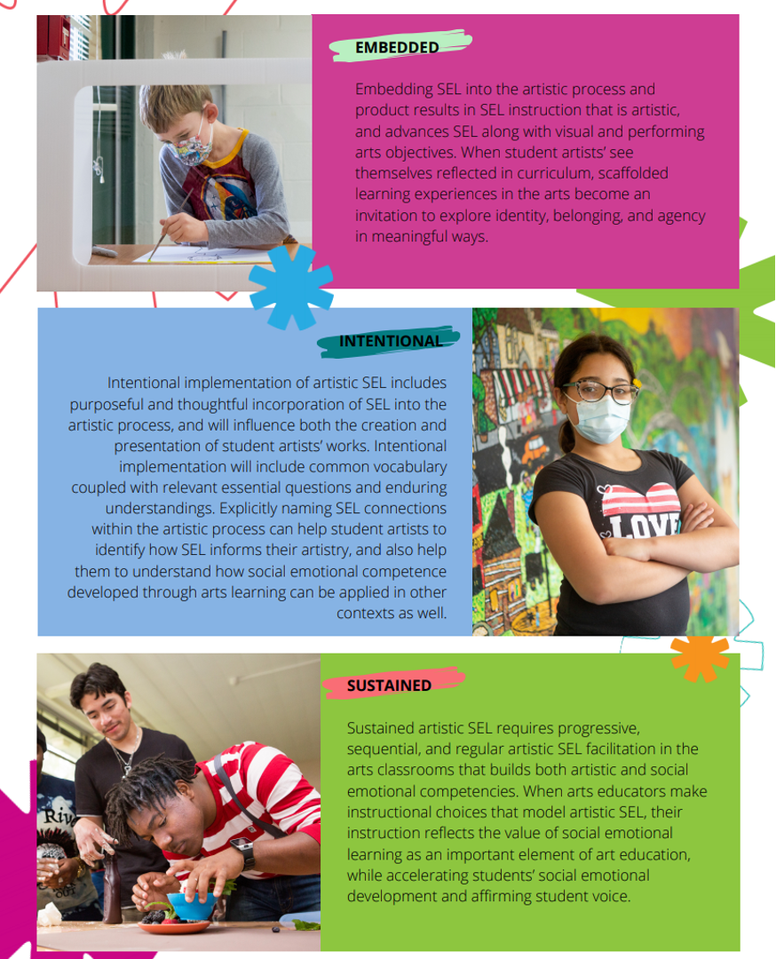
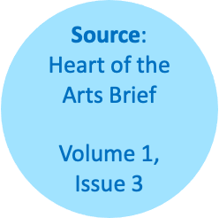
EMBEDDED
INTENTIONAL
SUSTAINED
VISIBLE
TENETS
Notes:
Yorel
Next I’ll share example of what this can look like

Slide 19
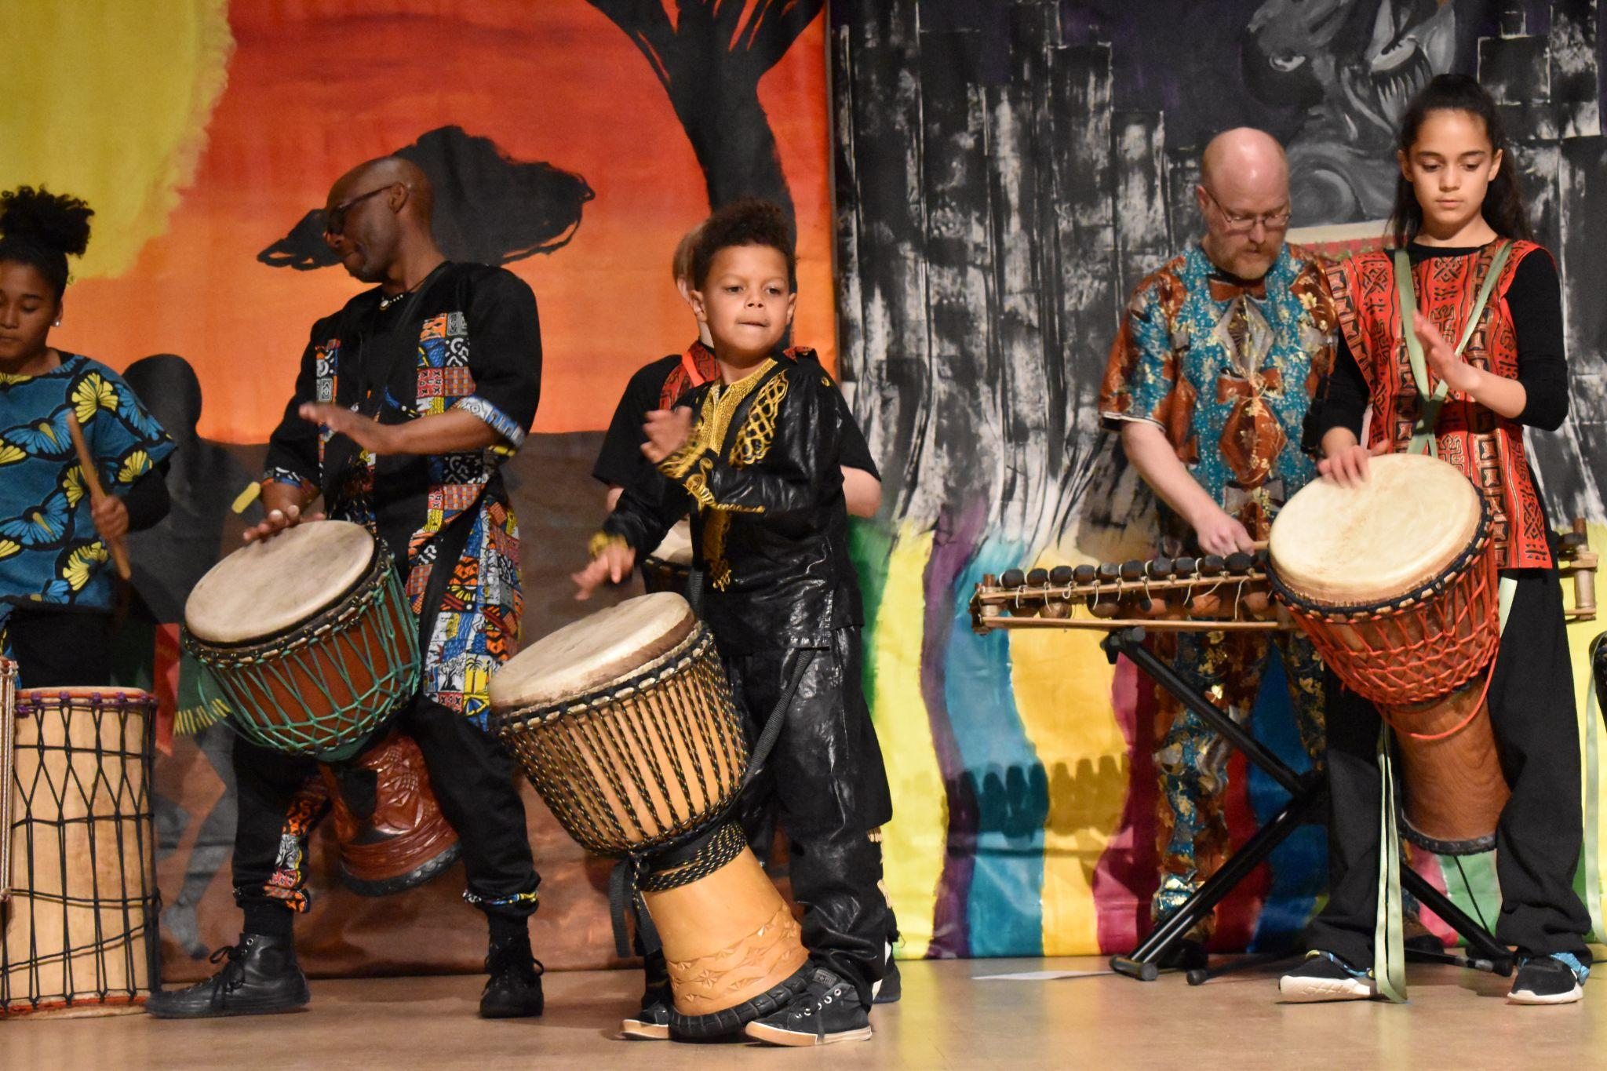
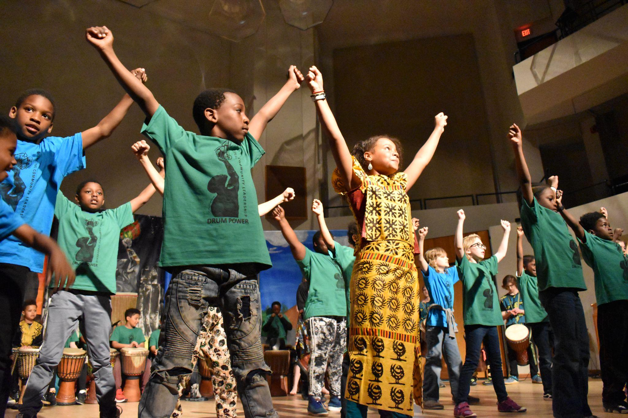
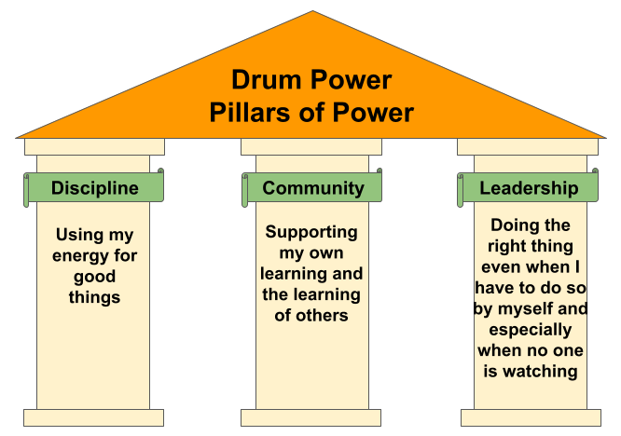
Notes:
YOREL
Quick DP history…4000 kids, basic shapes & content & how I got there to address IAB through STAY
AND prof learning which you will hear more about later helps folks create core values and systems for healthy classrooms and SEL practice like this one. Building an ENVIRONMENT — KIRA story;
As Principal Investigator of our NEA-funded research lab at UW-Madison I’ve collecting data on outcome for students–NEXT SLIDE
•Select SEL skills/competencies (like goal setting, self-awareness or leadership)— by asking What do you and your students/children need to learn and practice? (and then for T We…
•Translate those skills/competencies into language, routines, plans and community commitments that students understand. And then for A we…take
•Action—Good Social emotional learning must come to life as student and teacher behaviors/actions that live in everything we do in class--And finally for Y we support…
•Youth Empowerment—Good SEL is driven by students to empower them to think critically, experience the benefits of SEL as a tool for accomplishing the goals they set for themselves and not focused on controlling student behavior. Personal goals drive learning goals; leadership is built into the important routines--not just small ones; critical thinking is the focus all the time even when it requires changing “my plan”

Slide 20
IDENTITY
AGENCY
BELONGING
Notes:
Yorel Main outcomes–then connections to IAB–& there are many more connections to them–eg feeling personally connected is a building block for feeling a sense of belonging
General expectations & impressions (item examples)
How would you describe your experience with the drumming class?
Why did you join the drum group?
What did you expect it to be like and why?
What was learned? (item examples)
Have you learned anything about yourself in drumming this year? If so what? (Prompts: “understand”, “discover”)
What was your least favorite thing? Why?
What was the most important thing you learned in drumming? Why?
Was drumming like other classes you have been in? How was it like other classes/ how was it different? (Prompts: Were the expectations the same? Was it run the same? Was your role the same? Were the rules the same?)
What do you know about the pillars? (item examples)
What does discipline mean to you?
What does it mean in action? Example?
Will it help you in other situations? If so, how?
Feeling personally connected to the class
I have a good time. I learn new things and just be in my own little world…my own little world is music and stuff… (Second year drummer, 5th grader)
The teacher as a trusted guide and caregiver
When I first joined [the School A drum class] I felt pretty nervous. It was a new thing and there were a lot of people in there and Mr. Lashley has an interesting teaching style. He’s a great teacher but very different than more traditional teachers. He’s very focused on discipline and he pushes people. He doesn’t let people stay down. He constantly pushes for them to be able to go farther and he makes them think that they can go farther. He tells people that they can, and he helps them do that. (6 year drummer, 10th grader)
The class as a special space to practice SEL as discipline, community and leadership
[The thing that would be most helpful for me is] probably the Pillars of Power, which are discipline, community and leadership, which probably saved my life during all the stuff happening [with me] at school. Sometimes I get mad a bit but then I feel like the discipline, leadership and community like, really helps me. Before I joined I didn’t feel like I had those powers and those strengths. So when I joined I felt like Mr. Lashley was a very optimistic person who could help me with my life. (3rd year drummer, 7th grader)
The most important thing I think I’ve learned from drumming is the sense of community and kind of how everyone is better as one. Everybody sounds better together and we are all stronger in a bundle than just like as stick. That’s how I kinda’ see it. We build each other up and help each other with that. (2nd year drummer, 4th grader)
Finding my power
I learned that I should not doubt myself…The most important thing I learned is probably that you should not give up and [to] keep trying. If you are doing drumming and you get something wrong and you just say ‘Oh I can’t do that’ then you’re never gonna learn it…This girl Samia does the breaks [leads the drummers playing instructions with her drum], and she’s really good at it but sometimes she messes up but she keeps trying and she doesn’t just say ‘Oh I can’t do this’ but she keeps going. And I learn from [watching] her that I should do that. (1st year drummer, 5th grader)
Now that we’ve looked at the outcomes working from selecting, translating, Acting toward Youth Empowerment through the Drum Power example let’s turn to how our Center works with and supports educators through professional learning…Scott will lead us through.

Slide 21
PROFESSIONAL LEARNING
Multi-Year Project with Teaching Artists: Young Audiences
Notes:
SCOTT
RAISE is a three-year engagement with 3 cohorts of approximately 150 arts educators from across the country with Young Audiences to support artistic SEL professional learning in making SEL work imbedded, intentional and sustained through a virtual learning, synchronous series of gatherings that include content we developed and facilitate along with the processes I just shared

Slide 22
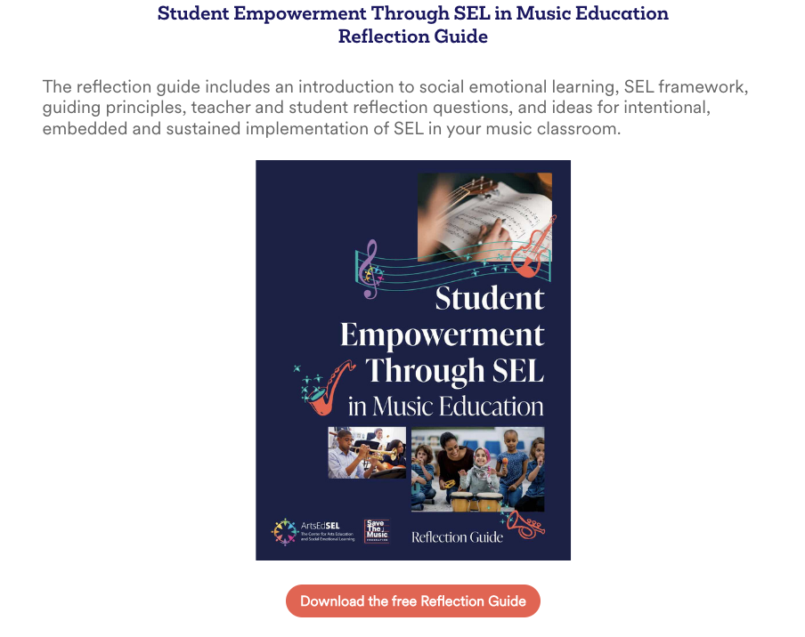
Notes:
Scott

Slide 23
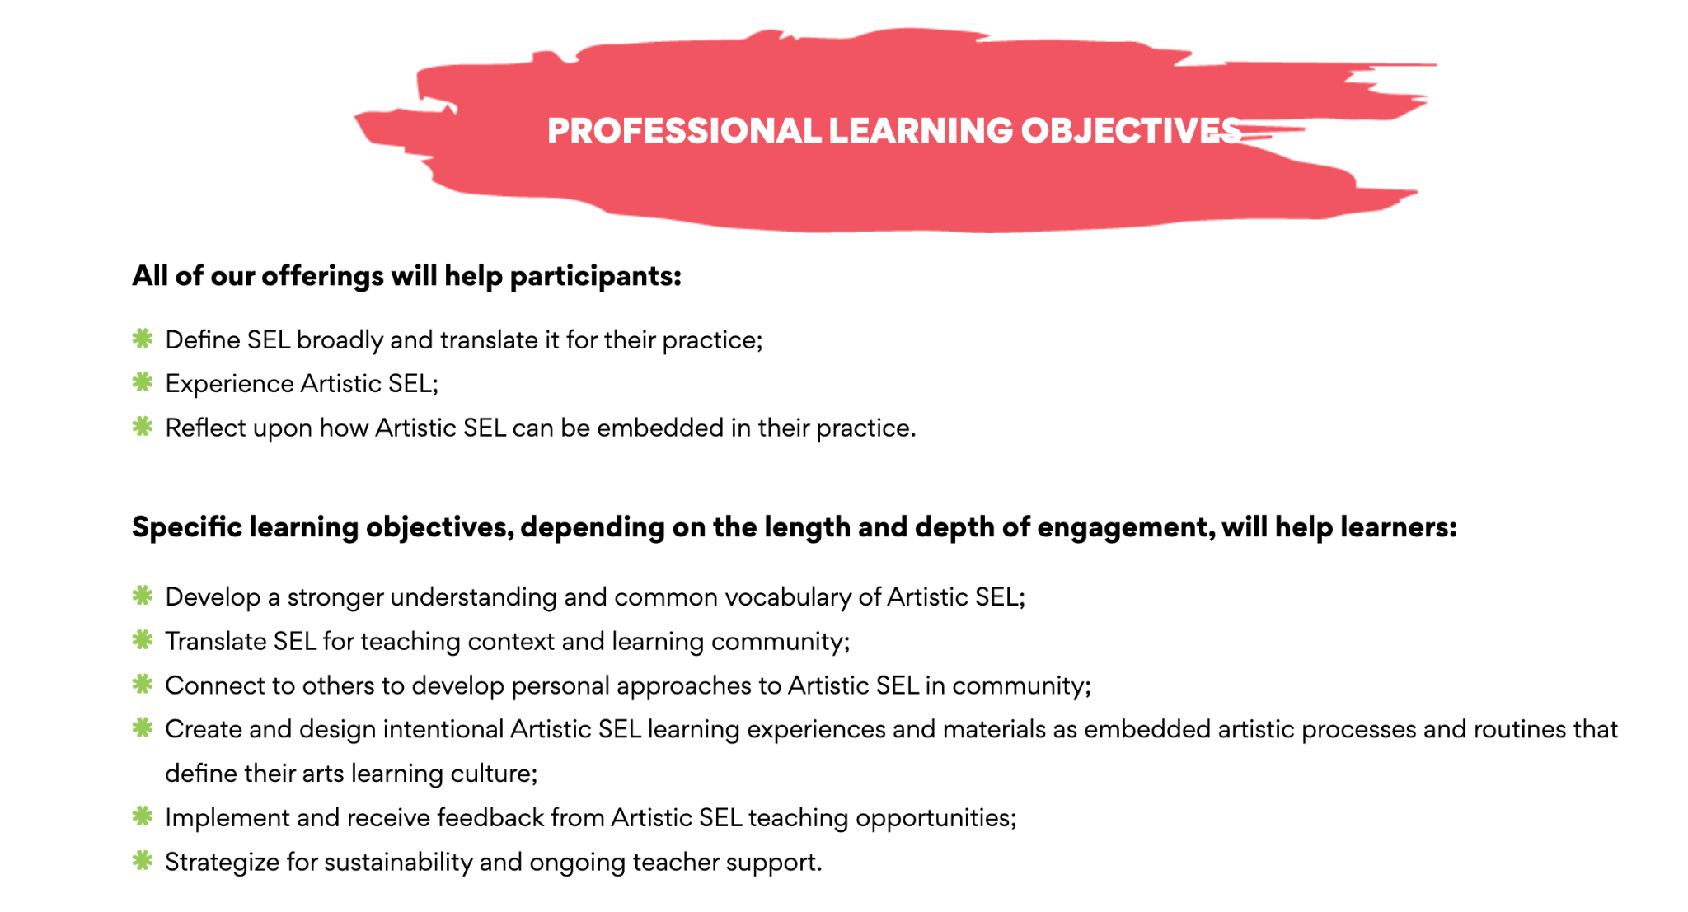
PROFESSIONAL LEARNING
Notes:
Kira–most recently we launched a new page on the ArtsEdSEL website, which (along with the brochure)
http://www.ArtsEdSEL.org/Professional-Learning

Slide 24
ARTISTIC SEL RESOURCES

Slide 25
https://artsedsel.org/
Notes:
Kira
Landing page of the website, where all resources can be found. Walk through live at end of this sequence (if time allows)

Slide 26
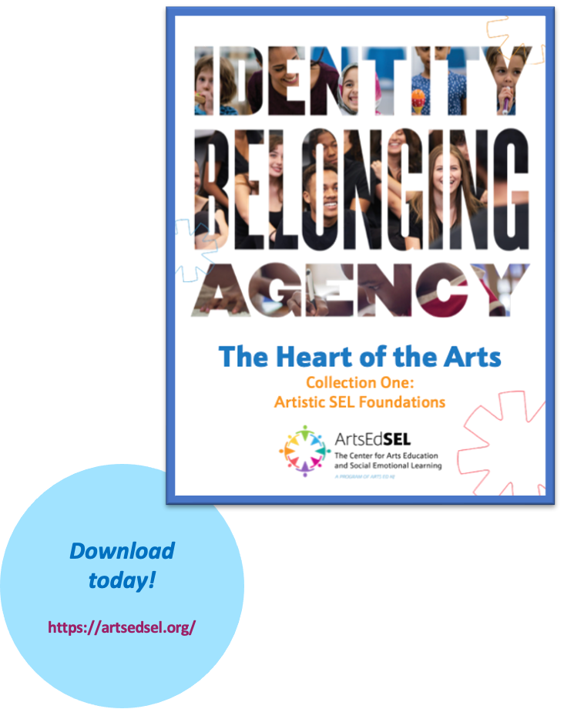
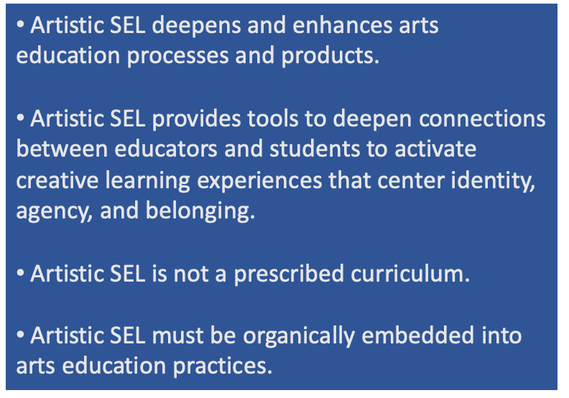
Heart of the Arts Collection
Notes:
Kira–Last year in celebration of #SELDay we released the Heart of the Arts Collection One. Includes foundations of Artistic SEL, as well as many other subtopics. Variety of authors, voices, and perspectives.

Slide 27
QUESTIONS
Notes:
Wendy with the whole team

Slide 28
THANK YOU!
Scott Edgar, Ph.D.: edgar@lakeforest.edu
Yorel Lashley, Ph.D.: lashley@wisc.edu
Wendy Liscow: wendy@artsednj.org
Kira Rizzuto: Kira@artsednj.org

